Slide 1
VISUALISING EMPLOYEE ATTENDANCE TRENDS WITH EXCEL CHARTS

Slide 2
INTRODUCTION :
Introduction• It can often be difficult to interpret Excel workbooks that contain a lot of data. Charts allow you to illustrate your workbook data graphically, which makes it easy to visualize comparisons and trends.

Slide 3
Planning and Designing the Excel Attendance Tracker:
1️⃣ Set attendance requirements. This is more like a documented policy and set of rules to guide an organization on matters relating to attendance. 2️⃣ Ensure that your Excel employee attendance tracker carries the requirements pointing out specific actions required from employees, including details of arrival to work and the number of working hours. 3️⃣ Incorporate guidelines for when employees can take leaves and what the process entails. That includes specifics like the length of breaks given each day, payroll calculations, and disciplinary measures for affected employees can be featured in the employee hours tracker. 4️⃣ With the attendance requirements for your Excel employee tracker determined, implement a tracker structure and layout. Thankfully, Excel has a structure of different spreadsheets. Apart from linking them, each sheet is structured with columns and rows.

Slide 4
Setting Up the Excel Attendance Tracker:
Start a new Excel spreadsheet and create columns for each date of the particular month. Create another column for employees to input their names in the left corner. Fill the columns matching weekends and public holidays with some color. Apply data validation. You’ll find that in the drop-down in the Data tab of the taskbar. Data Validation prevents inconsistency in inputs from employees. Use the Home tab to lock the cells beside the others where employees need to enter their data

Slide 5
Attendance tracking with a point system:
Point allocation: Points are assigned based on specific attendance behaviors, providing a quantitative measure of attendance reliability. Thresholds and rules: Defined thresholds determine the consequences associated with accumulating points over a given period. This can include disciplinary actions or rewards based on attendance performance. Tracking and monitoring: Excel spreadsheets are used to record and calculate points accrued by employees, providing a transparent and accessible way to track attendance trends over time.

Slide 6
Building Attendance Tracking Formulas:
1. Create a data set that has proper parameters. For example, you can have a staff attendance tracker for seven team members, including information about the days they attended to calculate their attendance percentage. 2. Apply the percentage formula. The proportion per hundred is applied to compute the percentage. In other words, the denominator and numerator are divided, and the result is multiplied by 100, with Numerator/Denominator being the Excel formula for percentages. Select the E5 cell Write this formula =(D5/C5)*100 Press Enter The first employee’s percentage of attendance displays Use the Fill Handle tool and drag it down from the E5 cell to the E11 cell 3. After following the steps above, the final result for all the employees is displayed on the employee attendance tracker spreadsheet.

Slide 7
Applying conditional formatting for data visualization:
Applying conditional formatting is important, as it helps visually explore and analyze data, spot problems, and identify trends and patterns. Further, conditional formatting makes it very easy to highlight interesting cells or ranges of cells. You can then visualize data with the components below.

Slide 8
Adding Automated Functions and Features:
Automating attendance sheet template Excel and other processes is easy to learn, and leaves a significant impact on your team’s productivity level. You can automate a vast range of functions and features without asking your team to constantly check on them. Excel automation examples include refresh data, new file creation, external data source connections, etc.

Slide 9
Creating dropdown lists for attendance status:
You can create a drop-down list for present attendance on Excel that allows you to choose an option from a list appearing when you click on a cell. Through the drop-down list, you can limit the options someone can select, ensuring they choose the ideal information. It’s also useful for keeping your records of employee attendance in Excel and performing large accounting data entry.
A | B | C
1. 98437 | Anbarasan | 60%
2. 98456 | Harish | 80%

Slide 10
Implementing data validation for error prevention :
Data validation is another feature you can add. It allows you to restrict the type, range, or format of the data that can be entered in a cell or a range of cells. This way, you can prevent a lot of errors. For example, data validation can be used to ensure that only specific values like numbers or dates are entered. It also ensures that the values meet specific criteria, such as matching a list of predefined options or between minimum and maximum values. To apply data validation to your employee attendance spreadsheet: Select the cell or range you want to validate Head to the Data tab, and click on Data Validation. Inside the Data Validation dialog box, you can choose from various settings and rules you’d want your data to follow

Slide 11
Including formulas for automatic calculations :
The automatic calculation is a program to consider. It can calculate new formula results automatically when a value or formula component changes. For example, if you have an Excel sheet attendance with the formula =A1+A2, Excel can automatically review the values in cells A1 and A2. It can then add them together to populate the sum in the cell containing the formula. If the value in A1 is changed, this Excel program can auto-calculate to generate the sum of the new value. The auto calculation program is important, as it can be used to create a formula for which you expect to change relevant data points. Even if you make changes to the attendance Excel spreadsheet, the formula still shifts to reflect that change. It comes in handy when you’re working with large amounts of data you have to update.

Slide 12
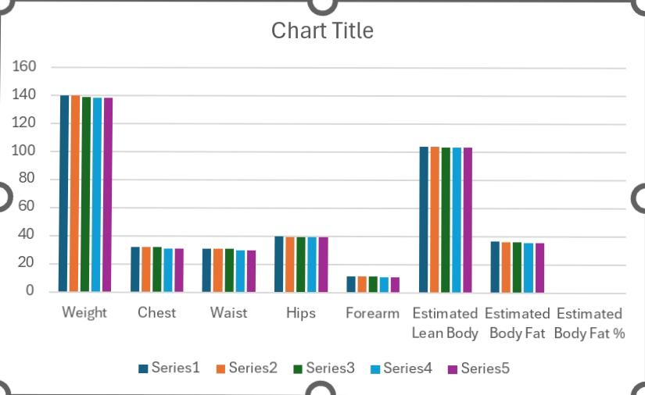
Result

Slide 13
Advantages of using Excel attendance tracker:
The attendance tracker Excel is a simple tool to use and operate. Employees do not need so much help to get used to the tools or input their details in the relevant columns. If there’s an issue with the Excel attendance template, you can always teach them how to use it. That includes setting up functions like formulas, tables, and charts.

